Slide 1
Project Title
Department of Engineering, Computing, and Cybersecurity
Team Member 1 Abdulaziz Alenazi
Professor: Dr. Gonzalo D. Parra

Slide 2
Outline
Why this project?
Objective
Timeline
Management System
Project Milestones
Prototype and Demo
Challenges and Limitations
Future Work
Conclusion
Resources

Slide 3
Why this project?
There is a constant increase in cyber attacks and threats, increasing need for training of cyber security professionals on various types of cyber attacks.
Nmap scans and Social-Engineering Toolkit are designed to help individuals develop skills in offensive security, particularly in identifying and exploiting vulnerabilities in a target network.
The project is designed to enable learners gain a deeper understanding of how to scan for vulnerabilities

Slide 4
Objective
Demonstrate use of Nmap to scans host and Metasploit framework-based Social-Engineering Toolkit to simulate and attack vulnerable information systems.
Investigate security posture of a target network and identify potential weaknesses that can be exploited by attackers.

Slide 5
Timeline
Description (Optional)

Slide 6
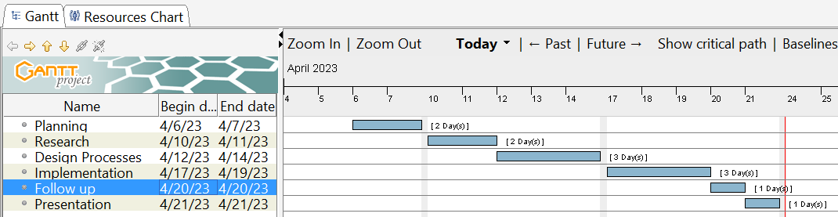
Place your Gantt chart here

Slide 7
Management System
Description (Optional)

Slide 8
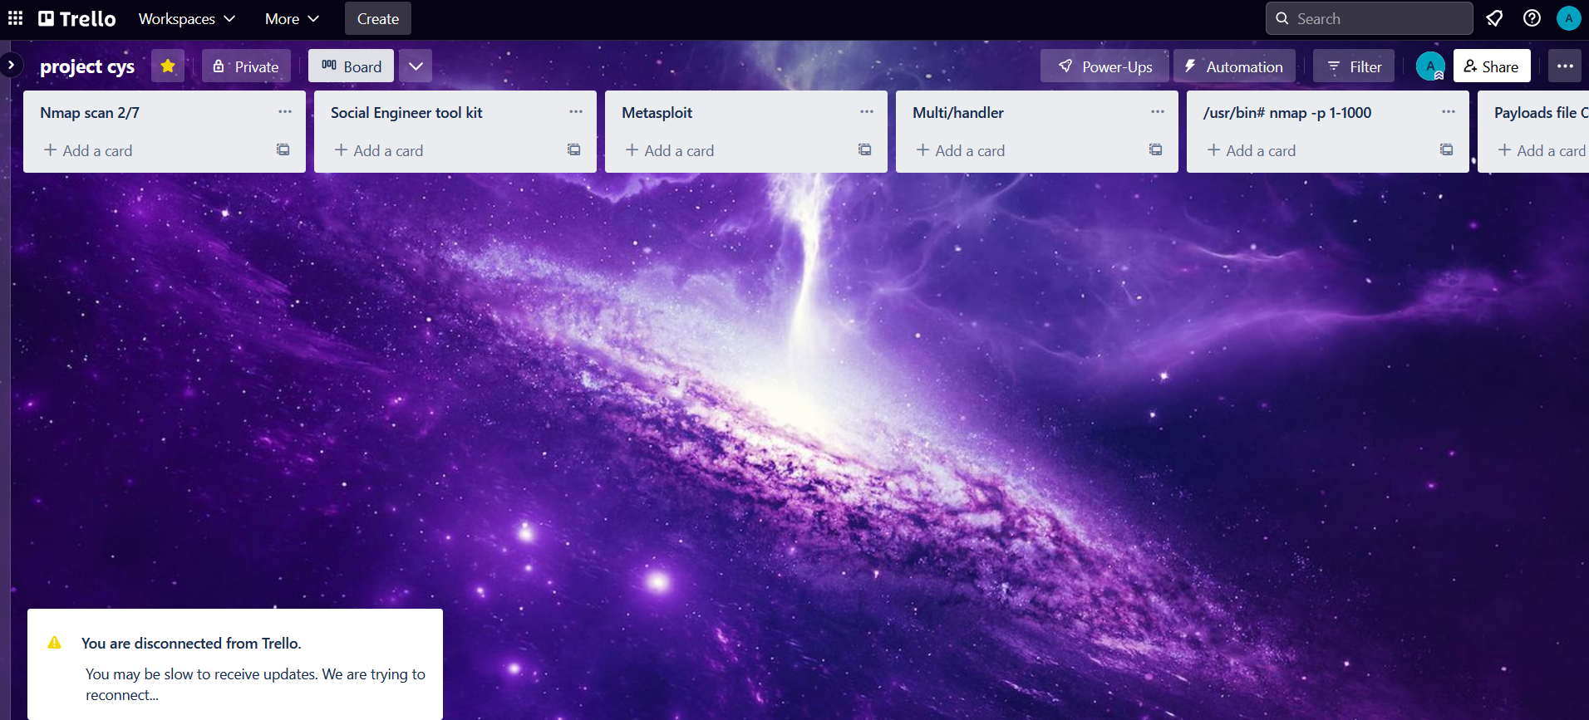
Place a screenshot of your Trello board here

Slide 9
Project Milestones
Install Nmap and confirm it can scan hosts to get open ports.
Using Nmap scan localhost (127.0.0.1) and grep its output to “/home/kali/Desktop/Results”.
Load Social-Engineering Toolkit and create a Payload and Listener.
Using Metasploit to Scan for Vulnerabilities
Specify the payload listener’s LHOST and reverse listener’s LPORT

Slide 10
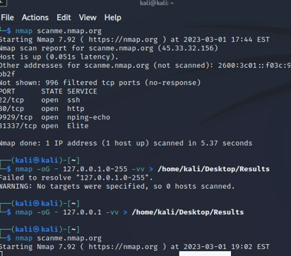
Milestone 1 Install Nmap & confirm it can scan hosts to get open ports To begin the scanning, there is checking if the Kali Linux VM has a working Nmap tool and if absent or not working as expected, get it installed.

Slide 11
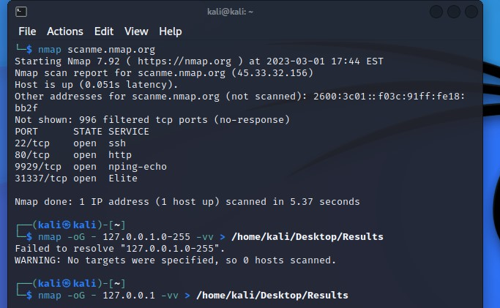
Milestone 2. Using Nmap scan localhost (127.0.0.1) and grep its output to “/home/kali/Desktop/Results” There is performing of Nmap scans, and determine the different types of scans that can be performed. This includes knowing how to specify target hosts, scan types, and options. It is also important to understand the difference between active and passive scans.

Slide 12
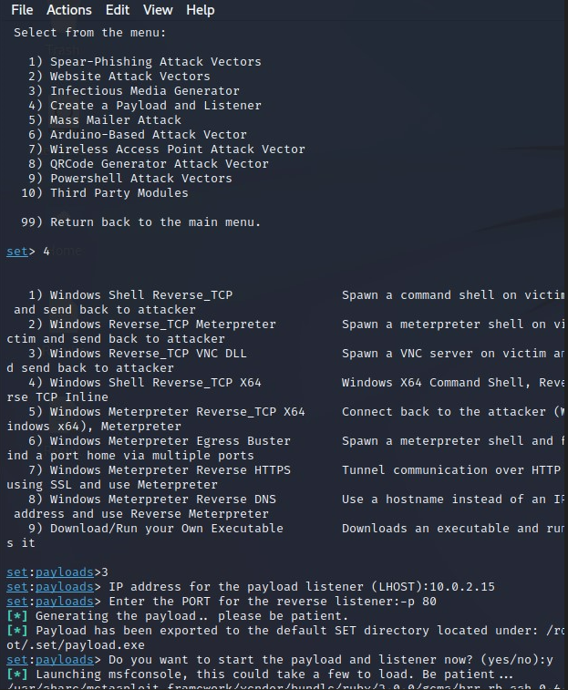
Milestone 3. Load Social-Engineering Toolkit and create a Payload and Listener How to load the Social-Engineering Toolkit, which is by executing the command “settoolkit” in the Kali Linux VM and “create a Payload and Listener”, which is by selecting option 4. There is also specifying the IP address of payload listener (LHOST) as 10.0.2.15 and port number of reverse listener as 80.

Slide 13
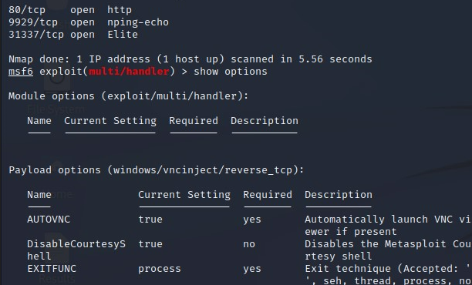
Milestone 4: Using Metasploit to Scan for Vulnerabilities There is learn how to use Metasploit that is availed via Social-Engineering Toolkit to scan for vulnerabilities on target hosts. This involves using Metasploit modules to scan for open ports and services, and identifying potential vulnerabilities that can be exploited
Description

Slide 14
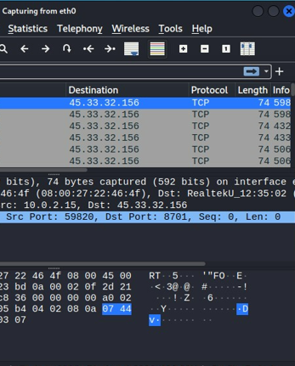
Milestone 5: Nmap Scans in Wireshark One can analyze Nmap scans in Wireshark. This involves capturing network traffic during a Nmap scan and using Wireshark to analyze the packets that are sent and received. This can help identify potential vulnerabilities or security issues that can be exploited by an attacker in the target system.

Slide 15
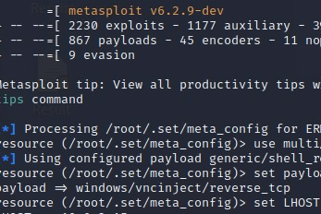
Milestone 6: Exploiting Vulnerabilities One can exploit vulnerabilities discovered to be present in target hosts during Metasploit scan. This involves using Metasploit modules to launch attacks against vulnerable services, gain access to the target system, and escalate privileges.
Description (Optional)

Slide 16
Challenges
The process of scanning for vulnerabilities, analyzing network traffic, and exploiting vulnerabilities can be complex and require a deep understanding of networking, operating systems, and other technical aspects.
Using Metasploit to exploit vulnerabilities can be resource-intensive and may require significant computing power and storage.

Slide 17
Limitations
Nmap scans and vulnerability exploitation can raise legal and ethical concerns
Networked systems can have a large number of interconnected devices, complex software stacks which can make their scanning impractical since they will take excessively long durations, and consume a lot of computing resources.

Slide 18
Future Work
Projects similar to this one should be repeated for other social engineering attacks for they equip learners with important skills in the field of offensive security and improve the ability to protect networks and systems from potential threats.
Projects to get and document time need to complete different types of scans should be executed for such details can are important in guiding educators in giving project deadlines.

Slide 19
Conclusion
State your conclusion
Our project’s code has been open-sourced in the following repository: https://github.com/cyberknowledge/Python3_Turorial

Slide 20
Conclusion Nmap is a popular tool used for network exploration and security auditing. It is often used to scan networks and identify open ports, services, and vulnerabilities. Metasploit is a framework used for penetration testing and exploiting vulnerabilities. Metasploit can be used to automate the process of exploiting vulnerabilities identified by Nmap scans. Wireshark is a network protocol analyzer that allows users to capture and analyze network traffic. It can be used to capture packets generated during Nmap scans and Metasploit exploitation attempts.
Description (Optional)

Slide 21
Resources
https://github.com/AlenaziAbdulaziz/-cyberknowledge.git
https://nmap.org/
https://www.tecmint.com/nmap-network-security-scanner-in-kali-linux/
https://unix.stackexchange.com/questions/505335/difference-between-nmap-local-ip-address-and-nmap-localhost

